Slide 1
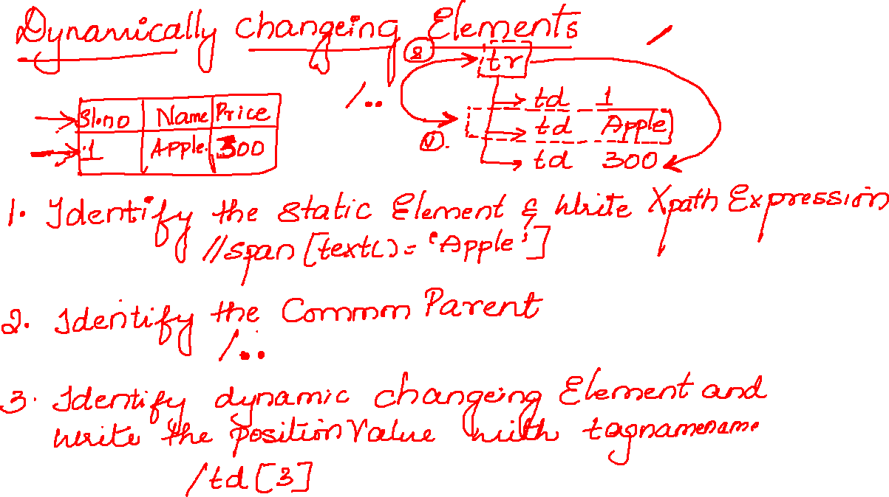

Slide 2
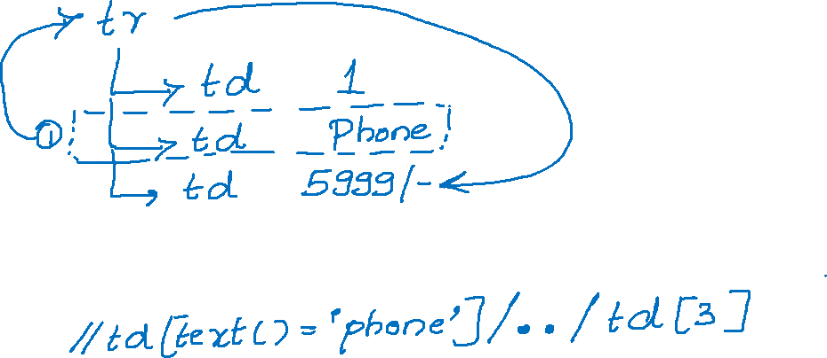

Slide 3


Slide 4
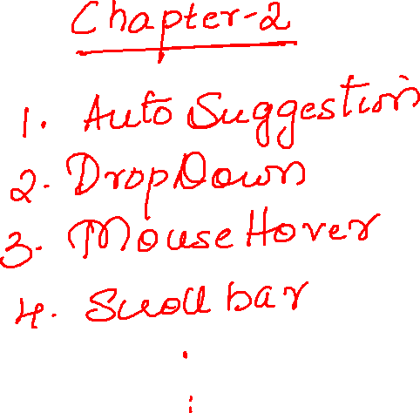

Slide 5

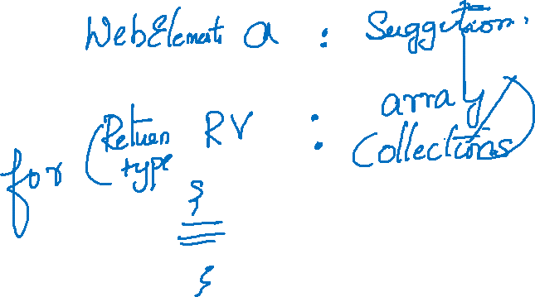


Slide 6
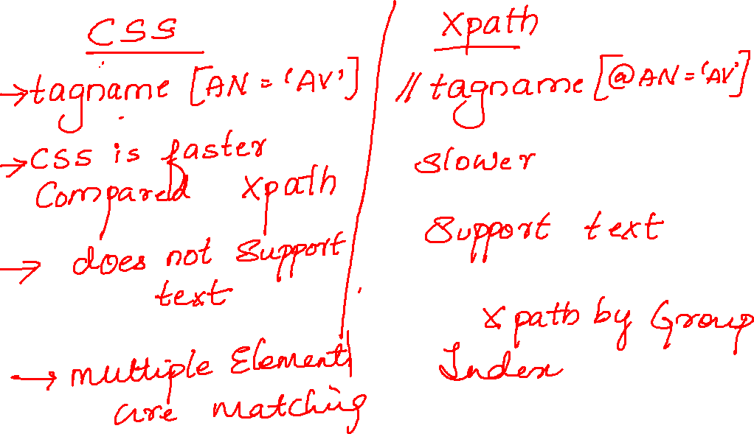

Slide 7


Slide 8



Slide 9
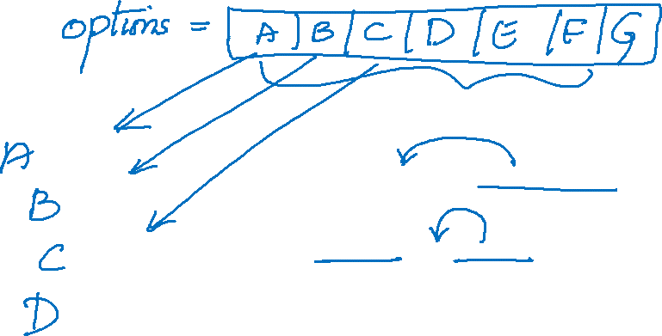
List<WebElement> options = s.getOptions();
System.out.println(options.size());
for(WebElement b:options) {
System.out.println(b.getText());
}

Slide 10


Slide 11
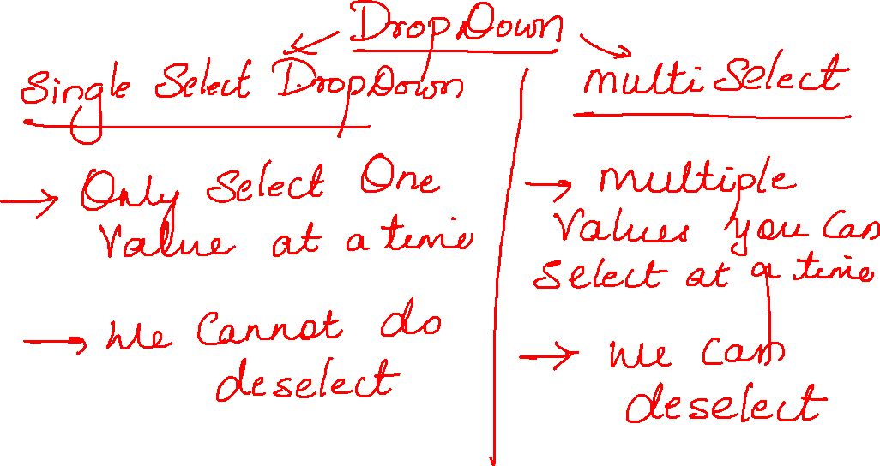

Slide 12
